Slide 1
Kinematics

Slide 2

Welcome to this Smart Lesson on kinematics.
After completing this Smart Lesson you will be able to:
Read kinematic problems and identify known values.
Identify unknown values and select kinematic equations.
Solve problems using the kinematic equations.

Slide 3
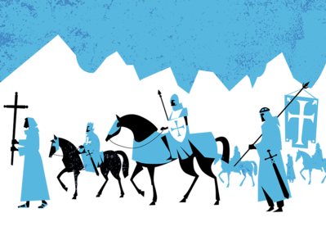
In this lesson, we will be learning about kinematics in the context of weapons of war in medieval times.
The medieval period was a violent period of history, and many different weapons were used during this time.
The simple bow and arrow was one of the most effective killing devices as it could be fired from distance on the battlefield or from the safety of a castle.

Slide 4
When we record the motion of an object, we are usually interested in these five quantities of motion:
• Initial speed (vi​) • Distance (d) • Acceleration (a)
• Final speed (vf​) • Time (t)
The great thing about these quantities is that if we know three values we can work out the values of either of the other two.

Slide 5
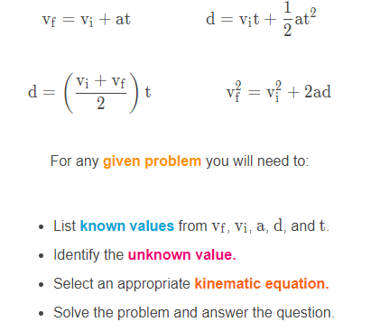
To work out unknown values we use equations called the kinematic equations. These equations will be provided to you in your exam.

Slide 6
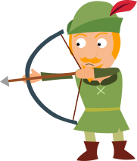
The first thing you need to do is list known and unknown values from vf​, vi​, a, d, and t.
Example
Have a look at the question below. Read and interpret the question carefully to match up the three known values to the list above.
Which quantity is mentioned in the question, but not given as a value?
"An arrow being pushed by a bow string accelerates at 160 ms−2 over 0.11 s. The initial speed of the arrow is 0 ms−1 How far does the arrow travel during this time?"

Slide 7
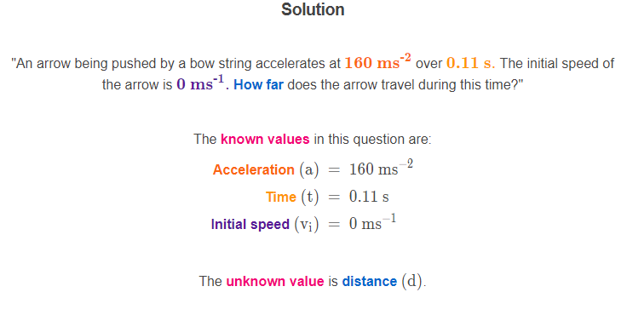

Slide 8
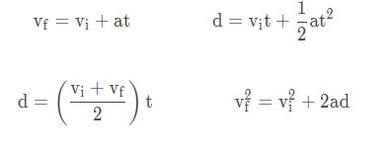
The next thing you need to do is find a kinematic equation that contains these four values.
Example
"An arrow being pushed by a bow string accelerates at 160 ms−2 over 0.11 s. The initial speed of the arrow is 0 ms−1 How far does the arrow travel during this time?"
Which equation below contains all four values mentioned in the question above?

Slide 9
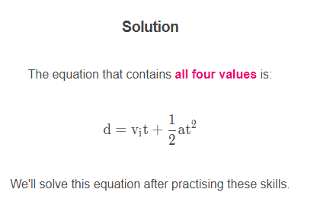

Slide 10
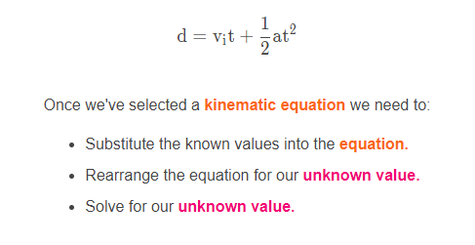
Let's take another look at our problem from the previous section:
Example
"An arrow being pushed by a bow string accelerates at 160 ms−2 over 0.11 s. The initial speed of the arrow is 0 ms−1 How far does the arrow travel during this time?"

Slide 11
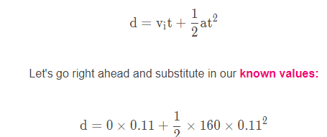
Solution
"An arrow being pushed by a bow string accelerates at 160 ms−2 over 0.11 s. The initial speed of the arrow is 0 ms−1 How far does the arrow travel during this time?"

Slide 12
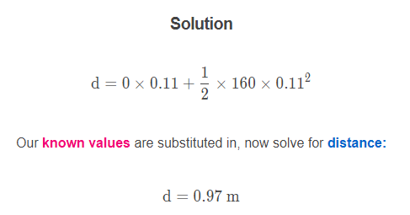

Slide 13
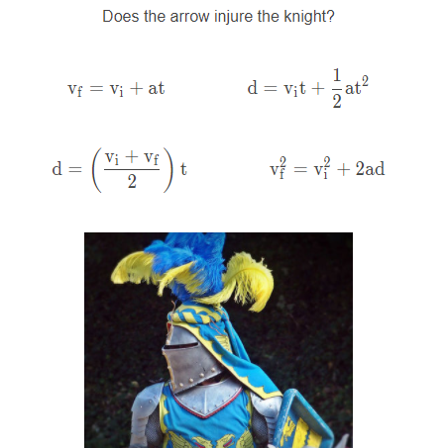
Let's figure out what happens when the arrow from the previous section hits its target.
Example
The arrow flies through the air and hits a knight on horseback. The knight is wearing armour which slows the arrow down at a rate of 2500 ms−2. The arrow is travelling at 24 ms−1 when it hits the knight, and must penetrate 10 cm into the armour to seriously injure the knight.

Slide 14
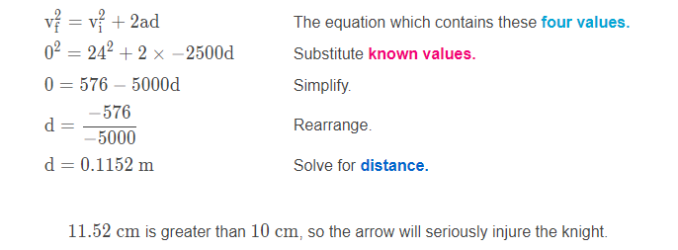
Solution
The arrow flies through the air and hits a knight on horseback. The knight is wearing armour which slows the arrow down at a rate of 2500 ms−2. The arrow is travelling at 24 ms−1 when it hits the knight, and must penetrate 10 cm into the armour to seriously injure the knight.
Does the arrow injure the knight?
The known values are acceleration, initial speed, and final speed.
The unknown value is distance.

